Slide 1


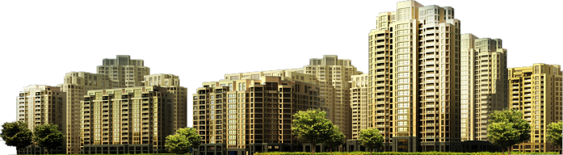

Ministry of Community and Territorial Development
THE STATE RESEARCH INSTITUTE OF BUILDING CONSTRUCTIONS
(NIISK, www.niisk.com)
Experimental evaluation of ETICS reliability factors
GENNADIY FARENYUK,
Director, Doctor of Technical Sciences, Prof.
UEAtc: Workshop ETICS
Liverpool– 31.10.2019

Slide 2
Dynamics of the Ukrainian TIM market, thousand m3

Slide 3
TIM by area of application

Slide 4
DBN V.1.2-11:2008
Main requirements for buildings and facilities. Energy saving
DBN V.2.6-31:2016
Heat insulation of buildings
Norms and standards for constructive solutions of heat insulation of buildings
DBN V.2.6-33:2018
Structures of exterior walls with façade heat insulation. Requirements for design, arrangement and operation
DSTU B V.2.6-34:2008
Structures of exterior walls with facade insulation. Classification and general technical requirements
DSTU B V.2.6-35:2008
(facade heat insulation and finishing industrial lagging)
DSTU B V.2.6-36:2008 (façade heat insulation and rendering)
DSTU B V.2.6-88:2009 (technical testing, technical control and monitoring)
DSTU B EN 13830:2015 (suspended facade. General technical conditions)
DSTU-N B ETAG 17:2013 Guideline for European technical approval of thermal insulation. Composite systems (ETICS) with rendering

Slide 5
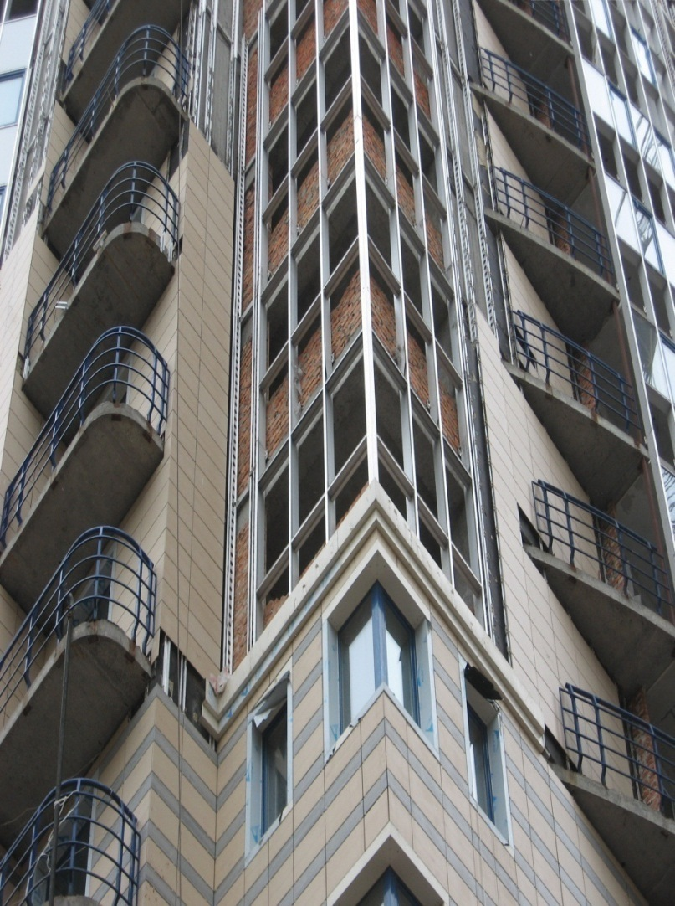
RELIABILITY REQUIREMENTS STANDATDIZATION
DBN V.1.2-11-2008 –establishes requirements for the incorporation of durability parameters of construction products in the relevant regulatory documents
The requirements are implemented in the following building regulations:
DBN V.2.6-31:2016 and DBN V.2.6-33
and in regulatory documents as follows
DSTU B V.2.6-34:2008, DSTU B V.2.6-35:2008 and DSTU B V.2.6-36:2008

Slide 6
RELIABILITY REQUIREMENTS STANDARTIZATION
DBN V.2.6-31-2016
Heat insulation of buildings
Establishes requirements for heat insulation parameters of envelope structures and buildings

Slide 7
Regulatory documents DBN V.2.6-33:2018, DSTU B V.2.6-34:2008, DSTU B V.2.6-35:2008, DSTU B V.2.6-36:2008, DSTU B V.2.6-88:2009
Mandatory requirements for reliability parameters of faсade thermal insulation
DBN B.V.2.6-33
Classification of systems :
ETICS
Suspended faсades
Transparent facades
DSTU B.V.2.6-34
Procedures of technical assessment and monitoring
DSTU B.V.2.6-88
Requirements for ETICS kits and test methods
DSTU B.V.2.6-35
pr DSTU-N B ETAG 004
Requirements for suspended façade kits and test methods
DSTU B.V.2.6-35
DSTU B EN 13830
DSTU-N B ETAG 17

Slide 8
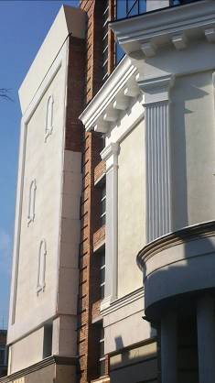
Definition from DBN V.2.6-33
The composite system consists of a supporting part of the exterior wall and a thermal insulation structure that is placed on the external surface of the wall and includes such products and components as a thermal insulation layer, a finishing coat and means of attaching those to the bearing element. The list, type and set of products and components are strictly fixed in the kit and their quantity may vary according to the demands of a project.

Slide 9
Class of composite system | Conditional height of buildings, Н, m | Flammability group of heat-insulating material |  |  | Flammability group of finishing material
 |  | nonflammable | F1 | F2 | nonflammable | F1 | F2
А | Н ≤ 15 | + | + | + | + | +¹⁾ | + ¹⁾*
 | 15<Н≤26,5 | + | + | + | + | +¹⁾
 | 26,5<Н≤73,5 | + |  |  | +
Б (ETICS) | Н ≤ 15 | + | + | + | +
 | 15<Н≤26,5 | + | + |  | +
 | 26,5<Н≤73,5 | + |  |  | +
В (suspended facade) | Н ≤ 15 | + | + | + | + | +¹⁾ | + ¹⁾*
 | 15<Н≤26,5 | + |  |  | + | +¹⁾
 | 26,5<Н≤73,5 | + |  |  | +
Г (transparent façade ) | Н ≤ 15 | + | + | + | +
 | 15<Н≤26,5 | + | + |  | +
 | 26,5<Н≤73,5 | + |  |  | +
«+» means the possible application

Slide 10
Basic physical and mechanical parameters of composite systems in accordance with DSTU B V.2.6.-34:2008 “Constructions of external walls with facade heat-insulation. Classification and general technical requirements”
Required A parameters | Classes |  |  |  | Indication of regulatory act or regulatory document | The name of the parameter in the relevant regulatory act or regulatory document normative act or normative document
 | А | Б | В | Г
1 Reduced resistance of heat transfer | + | + | + | + | DBN V.2.6-31:2006 | The reduced resistance of the heat transfer of the composite system should be not less than the minimum permissible heat transfer resistance in accordance with 2.1 DBN В.2.6-31
 |  |  |  |  | DBN V.1.2-11-2008 | Reduced resistance of heat transfer
 |  |  |  |  | prDSTU-N B ETAG 004:201Х | 5.1.6.1 Resistance of heat transfer
 |  |  |  |  | DSTU-N B ETAG 017:2013 | 6.6.1 Resistance of heat transfer
2 Adhesion of thermal insulation layer and protective-finishing layer | + | - | - | - | DSTU B V.2.6-36:2008 | Adhesion of base and protective-finishing layer of board insulation
 |  |  |  |  | prDSTU-N B ETAG 004:201Х | 6.1.4.1 Adhesion
 |  |  |  |  | DSTU-N B ETAG 017:2013 | 5.4.2.1 Adhesion of finishing and isolation product

Slide 11
3 Thermal insulation layer:
- period of efficient service; | + | + | + | + | DSTU B V.2.6-35:2008 | period of efficient service of thermal insulation layer
 |  |  |  |  | prDSTU-N B ETAG 004:201Х | Service life
 |  |  |  |  | DSTU-N B ETAG 017:2013 | À.4.2 Service life (for products)
- thermal conductivity; | + | + | + | + | DBN V.1.2-11-2008 | thermal conductivity in the calculation conditions
 |  |  |  |  | DSTU B EN 13830:2014 | Heat transfer
- Density; | + | + | + | + | DBN V.1.2-11-2008 | Density
 |  |  |  |  | prDSTU-N B ETAG 004:201Х | C.2.1 Density measurement
 |  |  |  |  | DSTU-N B ETAG 017:2013 | С.3.2 Density
- axial tensile strength; | + | + | + | + | DBN V.1.2-11-2008 | Stretching tensile strength
 |  |  |  |  | prDSTU-N B ETAG 004:201Х | Tensile strength
 |  |  |  |  | DSTU-N B ETAG 017:2013 | С.3.3 Tensile test
- compressive strength at 10 per cent of linear deformation; | + | + | + | + | DBN V.1.2-11-2008 | compressive strength at 10 per cent of linear deformation;
- Thickness | + | + | + | + | prDSTU-N B ETAG 004:201Х | C.2.2.2 Thickness
4 Thickness of the air layer | - | + | + | + | DSTU B V.2.6-36:2008 | Thickness of the air layer
5 Effort to pull out anchor from the bearing wall | + | - | + | + | DSTU B V.2.6-35:2008 | Effort to pull out anchor for attachment of façade heat insulation structures
 |  |  |  |  | DSTU B V.2.6-36:2008 | Effort to pull out anchor
 |  |  |  |  | prDSTU-N B ETAG 004:201Х | Adhesion of base coat and heat insulation material
 |  |  |  |  | DSTU-N B ETAG 017:2013 | 5.4.2.2 Tensile test of anchoring

Slide 12
6 Permissible lowering of the heat transfer resistance of the system after the reliability test of thermal insulation of structure | + | + | + | + | DSTU B V.2.6-35:2008 | Lowering of the heat transfer resistance of the system after the reliability test of thermal insulation
 |  |  |  |  | DSTU-N B V.2.6-88:2009 | Experimental determination of the estimated level of heat transfer resistance of composite system (in case if regulatory requirements are not provided)
 |  |  |  |  | prDSTU-N B ETAG 004:201Х | Minimum value of heat transfer resistance
 |  |  |  |  | DSTU-N B ETAG 017:2013 | Minimum value of heat transfer resistance
7 Permissible deviations from the design position (of façade, finishing boards, air layer , mounting elements) | - | + | + | + | DSTU B V.2.6-35:2008 | Deviation from the design position of facade and its elements in the plane of the wall
8 Number of anchors to attach the thermal insulation frame to the bearing wall | - | - | + | + | DSTU B V.2.6-35:2008 | Number of anchors to attach the thermal insulation per 1 m²
 |  |  |  |  | prDSTU-N B ETAG 004:201Х | Number of mounting elements in the thermal insulation panel
 |  |  |  |  | DSTU-N B ETAG 017:2013 | Minimum value of mechanical mounting elements
9 Resistance of the finishing layer to the influence of climate | + | + | + | + | DSTU B V.2.6-36:2008 | Resistance of system to the climate
 |  |  |  |  | prDSTU- N B ETAG 004:201Х | 5.1.4.3 Wind load resistance of mechanically anchored composite system
 |  |  |  |  | DSTU-N B ETAG 017:2013 | 6.4.1 Wind load resistance

Slide 13
10 Impact resistance of finishing layer | + | + | + | - | DSTU B V.2.6-36:2008 | Impact resistance
 |  |  |  |  | prDSTU-N B ETAG 004:201Х | 5.1.3.3Impact resistance
 |  |  |  |  | DSTU-N B ETAG 017:2013 | Impact resistance
11 Impact safety of finishing layer | - | - | - | + | DSTU B EN 13830:2014 | Impact strength
12 Mass of 1 m ² of facade insulation in the state of operational humidity | + | - | - | - | DSTU B V.2.6-36:2008 | Mass of 1 m ² of composite system without leveling coat
13 Coefficient of vapor permeability of thermal insulation and air protection layers | + | + | + | + | DSTU B V.2.6-35:2008 | Coefficient of vapor permeability
14 Vapor permeability resistance of the finishing layer | + | - | - | - | DSTU B V.2.6-36:2008 | Vapor permeability resistance of the finishing layer
 |  |  |  |  | prDSTU-N B ETAG 004:201Х | 5.1.3.4 Vapor permeability (Vapor permeability resistance ) 5.2.3.2 Vapor permeability resistance 6.1.3.4 Vapor permeability (resistance of water vapor diffusion)
 |  |  |  |  | DSTU-N B ETAG 017:2013 | 5.3.3 Vapor permeability (resistance of water vapor diffusion) 6.3.3 Vapor permeability
15 Requirements for anti-corrosion protection of mounting elements of facade heat insulation frame | - | + | + | + | DSTU B V.2.6-35:2008
 |  |  |  |  | prDSTU-N B ETAG 004:201Х | All materials should have natural resistance or be protected from corrosion or mold effects.
 |  |  |  |  | DSTU-N B ETAG 017:2013 | All materials must have natural resistance or be protected from corrosion or mold effects.

Slide 14
16 Requirements for material, geometric size of anchors and anchoring depth | + | - | + | + | DSTU B V.2.6-35:2008
17 Air permeability resistance of thermal insulation and air insulation layer(s) | - | + | + | + | DSTU B V.2.6-35:2008 | Air permeability resistance of thermal insulation layer(s)
 |  |  |  |  | DSTU B EN 13830:2014 | Air permeability
18 Requirements for grades of metal for frame fasteners, clamp irons, etc., and the thickness of the profiles of the fastening frame | - | + | + | + | DSTU B V.2.6-35:2008
19 Permissible length of mounting elements of risers and crossbars | - | - | + | + | DSTU B V.2.6-35:2008 | Length of mounting elements of risers and crossbars
20 Flammability groups of thermal insulation materials | + | + | + | + | DBN V.2.6-33:2008 | Flammability group of insulation materials (nonflammable, flammable 1, flammable 2)
21 Flammability groups of finishing materials | + | - | + | - | DBN V.2.6-33:2008 | Flammability group of finishing materials (nonflammable, flammable 1, flammable 2)
22 Spread of flame of facade heat insulation structure | + | - | - | - | DBN V.2.6-33:2008 | 6.8.3 Façade spread of flame of the system is estimated according to the results of field fire tests
23 Water resistance | - | - | - | + | DSTU B EN 13830:2014 | Water resistance
 |  |  |  |  | prDSTU-N B ETAG 004:201Х | 5.1.3.2 Water resistance
 |  |  |  |  | DSTU-N B ETAG 017:2013 | 6.3.1 Water resistance
24 Deformability of the frame under wind loads | - | - | - | + | DSTU B EN 13830:2014 | Wind load resistance

Slide 15
Requirements for energy performance and reliability
A prerequisite for energy efficiency is the condition of thermal reliability, as a house cannot be energy-efficient if its thermal envelope is not reliable by thermotechnical indicators. Changing the structural principles of the thermal envelope, i.e. the transition from single-layer brick or concrete walls to multilayer walls with the façade heat insulation requires a fundamental change in the methodology for assessing the operational suitability of modern envelope structures

Slide 16
Classification of failures of façade system with plaster layer
Failure of ETICS
Failure of waterproof level
Breaking of heat insulation layer
Failure of anchoring structures

Slide 17
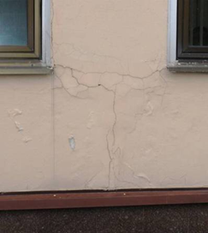
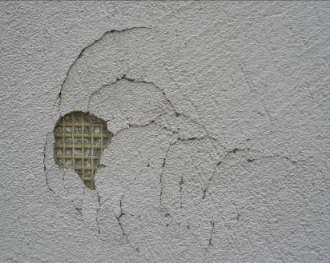
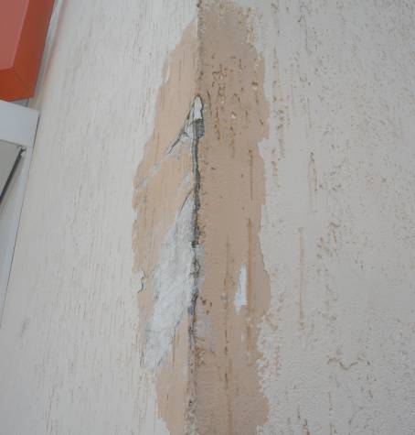
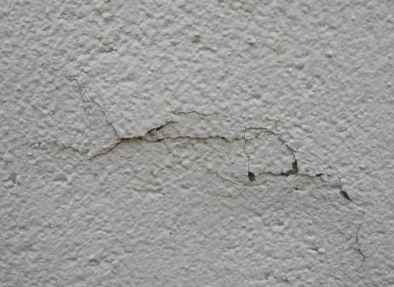
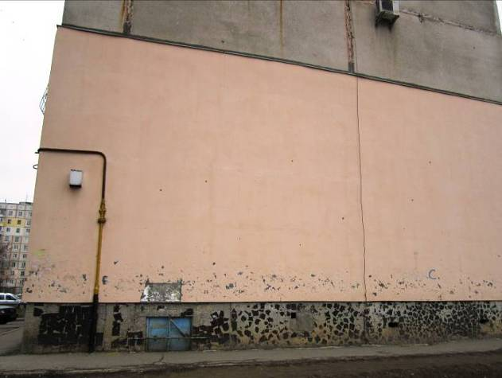
Examples of the failures of facade insulation structures with rendering

Slide 18
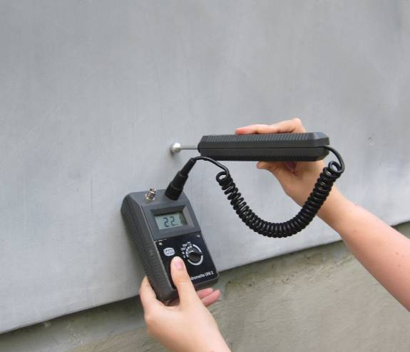
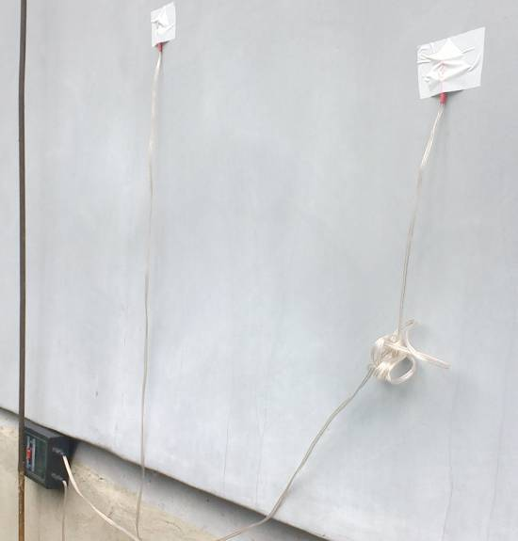
DSTU-N B V.2.6 – 88:2009 “ CONSTRUCTIONS OF EXTERIOR WALLS WITH FACADE HEAT-INSULATION. GUIDANCE ON APPROBATION, TECHNICAL SUPERVISION AND MONITORING”
In the process of monitoring the following works are executed :
А. Surveys of:
– appearance of finishing layer;
– flatness of facade heat - insulation external surface;
– integrity of facade heat insulation fit to the load-bearing part of wall and load-bearing components of building.
Б. Experimental determination of :
– moisture content in the thermal insulation layer (layers);
– the actual level of thermal resistance of insulated external wall (in case of failure to comply with normative requirements).
.

Slide 19
Reliability criterion of system (heat insulation envelope of the building, enclosing structure)
The physical essence of the criterion is to determine the effectiveness of enclosing structure during the target service life with possible changes in the state of the elements of the structure under the influence of various (climatic, mounting, operational, etc.) factors.

Slide 20
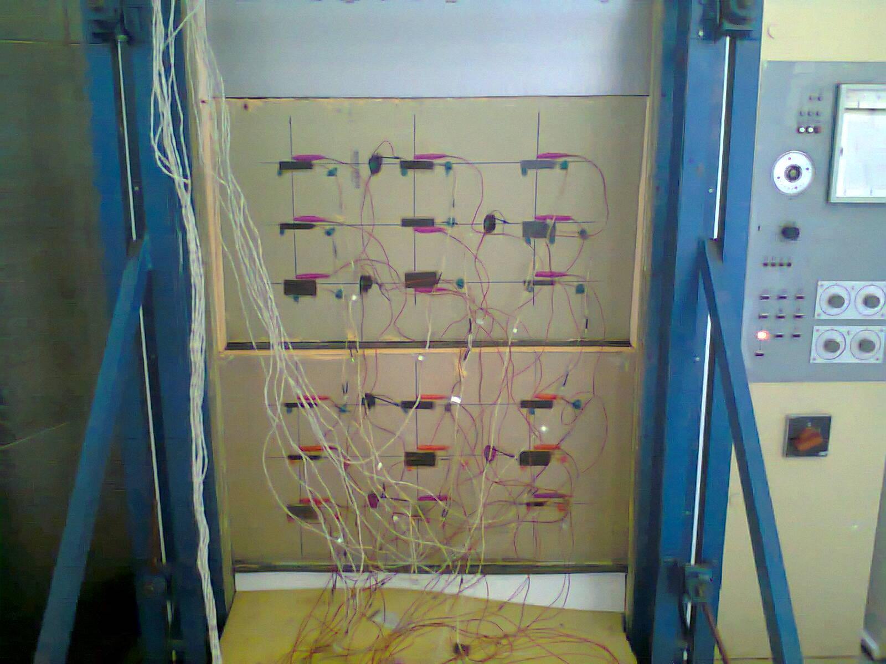
The process of testing of facade heat insulation structures with rendering for resistance to climatic influences
Number of cycles | Fragment resistance to the heat transfer, m²∙KW
0 | 3,07
10 | 3,01
20 | 3,01
30 | 2,98
40 | 2,74
50 | 2,68
60 | 2,68

Slide 21
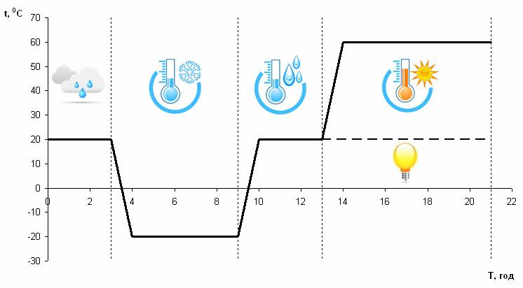
Tests of resistance to climatic factors: requirements of DSTU B.V.2.6-36, ЕTAG 004

Slide 22
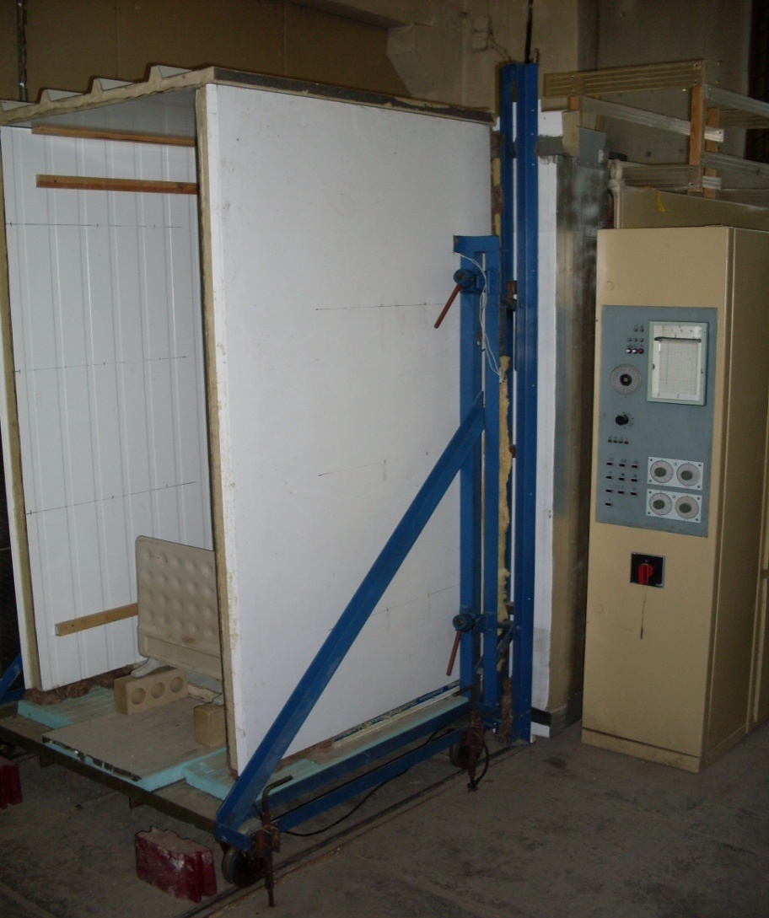
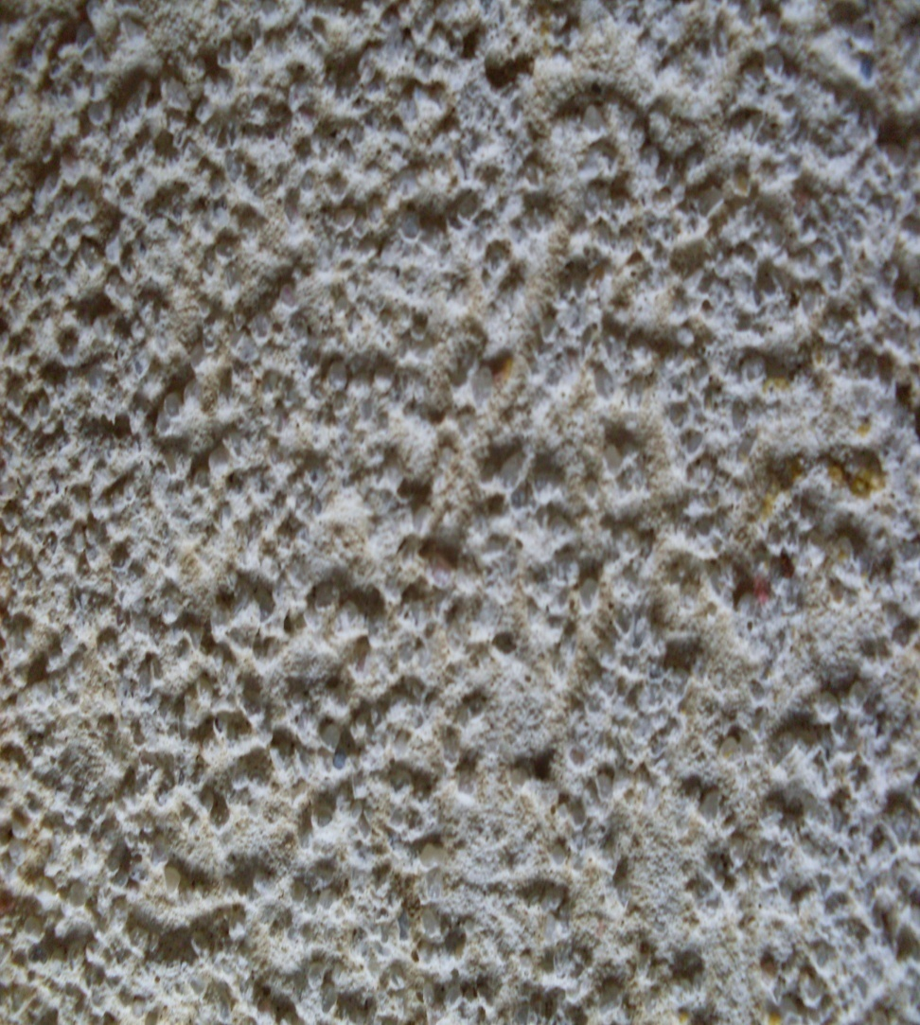
The process of testing of facade heat insulation structures with rendering for resistance to climatic influences

Slide 23
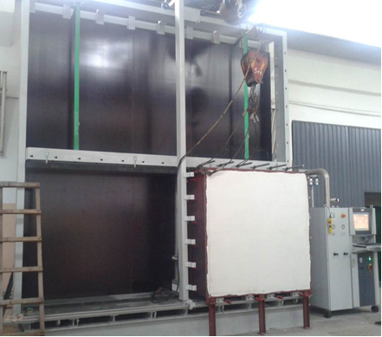
Experimental studies of air permeability of ETICS

Slide 24

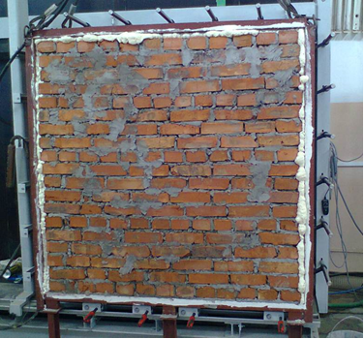
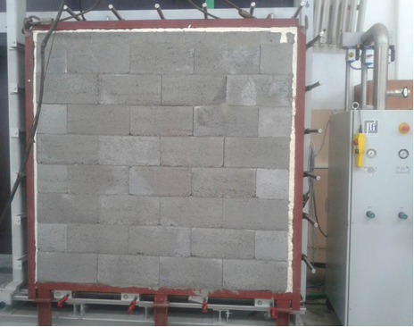
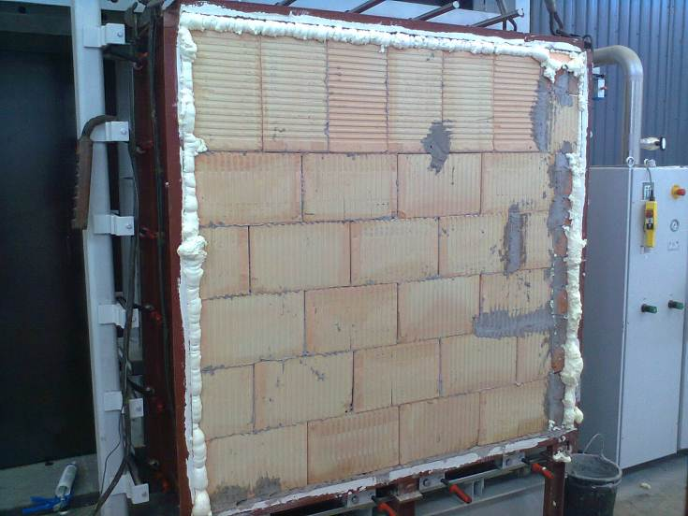
Investigation of thermal reliability indicators for the external walls structures with facade heat insulation, finishing of thin-wall elements and ventilated air layer
Structure with an internal (bearing) brick layer made of clay blocks
Structure with an internal (bearing) layer made of claydite concrete blocks

Slide 25
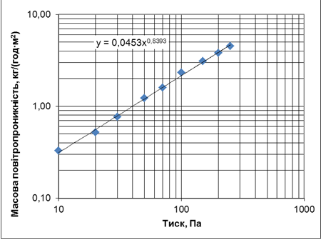
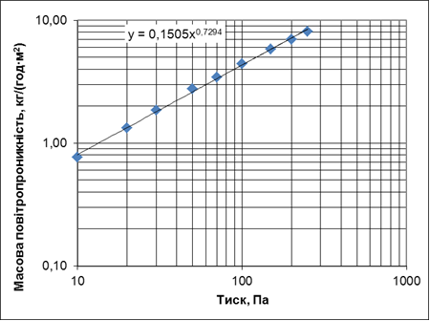
Investigation of air permeability of ETICS structural systems
Dependency of mass air permeability from pressure drop in ETICS with 120 mm thick rock wool thermal insulation and base made of 250 mm thick ceramic void blocks
Dependency of mass air permeability from pressure drop in ETICS with 120 mm thick rock wool thermal insulation and base made of 250 mm thick loam bricks

Slide 26
Investigation of air permeability of ETICS structural systems
The investigation results of air permeability of ETICS structural system with 120 mm thick rock wool thermal insulation and base made of 250 mm thick ceramic void blocks
The investigation results of air permeability of ETICS structural system with 120 mm thick rock wool thermal insulation and base made of 250 mm thick loam bricks
Indicator of filtration mode | 0,84
Pressure drop ΔР Pa | 10 | 20 | 30 | 50 | 70 | 100
Volume air permeability m³/(hour·m²) | 0,27 | 0,43 | 0,63 | 1,01 | 1,32 | 1,91
Mass air permeability kg/(hour·m²) | 0,33 | 0,52 | 0,76 | 1,22 | 1,60 | 2,31
Relevant height of building | 30,56 | 38,38 | 39,29 | 40,85 | 43,75 | 45,20
Standard resistance of air permeability, (m²· hour ·Pа)/kg | 20 | 40 | 60 | 100 | 140 | 200
Compliance to the standard requirements | + | - | - | - | - | -
Indicator of filtration mode | 0,73
Pressure drop ΔР Pа | 10 | 20 | 30 | 50 | 70 | 100
Volume air permeability m³/(hour·m²) | 0,63 | 1,1 | 1,52 | 2,27 | 2,85 | 3,65
Mass air permeability kg/(hour·m²) | 0,76 | 1,33 | 1,84 | 2,75 | 3,45 | 4,42
Air permeability resistance, (m²· hour ·Pа)/kg | 13,10 | 15,00 | 16,28 | 18,17 | 20,27 | 22,61
Standard resistance of air permeability, (m²· hour ·Pа)/kg | 20 | 40 | 60 | 100 | 140 | 200
Compliance to the standard requirements | - | - | - | - | - | -

Slide 27
Investigation of air permeability of ETICS structural systems
The investigation results of air permeability of ETICS structural system consisting of 120 mm thick rock wool thermal insulation, base made of 250 mm thick ceramic void blocks and 5 mm thick rendering
The investigation results of air permeability of ETICS structural system consisting of 120 mm thick rock wool thermal insulation, base made of 250 mm thick ceramic void blocks and 15 mm thick rendering
Pressure drop, ΔР Pa | 10 | 20 | 30 | 50 | 70 | 100
Relevant height of building | 6 | 11 | 16 | 26 | 36 | 51
Air permeability resistance, (m²· hour ·Pа)/kg | 51,40 | 51,34 | 51,36 | 51,20 | 51,17 | 51,01
Standard resistance of air permeability, (m²· hour ·Pа)/kg | 20 | 40 | 60 | 100 | 140 | 200
Compliance to the standard requirements | + | + | - | - | - | -
Pressure drop, ΔР Pa | 10 | 20 | 30 | 50 | 70 | 100
Relevant height of building | 6 | 11 | 16 | 26 | 36 | 51
Air permeability resistance, (m²· hour ·Pа)/kg | 146,07 | 146,01 | 146,03 | 145,87 | 145,84 | 145,68
Standard resistance of air permeability, (m²· hour ·Pа)/kg | 20 | 40 | 60 | 100 | 140 | 200
Compliance to the standard requirements | + | + | + | + | + | -

Slide 28



Thank you for your attention!

